Slide 1
Chapter 7: Energy
694991
Notes:
Preparation by Pawan Sr . Lecturer physics

Slide 2
Prepare by Pawan Sharma Lecturer in Physics
Govt Hr. Sec. School Barolla

Slide 3
This lecture will help you understand:
Energy
Work
Power
Mechanical Energy: Potential and Kinetic
Work-Energy Theorem
Conservation of Energy
Machines
Efficiency
Recycled Energy
Energy for Life
Sources of Energy

Slide 4
Energy
A combination of energy and matter make up the universe.
Energy
  Mover of substances
  Both a thing and a process
  Observed when it is being transferred or being transformed
  A conserved quantity

Slide 5
Energy
Property of a system that enables it to do work
Anything that can be turned into heat
  Example: Electromagnetic waves from the Sun
Matter
  Substance we can see, smell, and feel
  Occupies space

Slide 6
Work
Work
  involves force and distance.
  is force x distance.
  in equation form: W = Fd.
Two things occur whenever work is done:
  application of force
  movement of something by that force

Slide 7
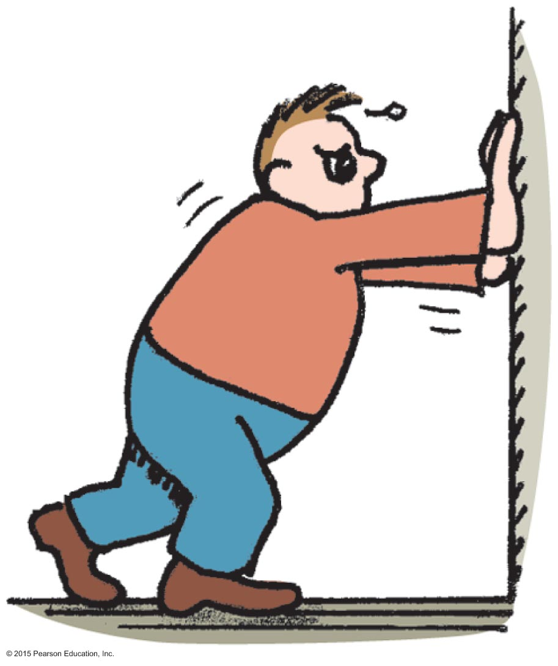
Work
CHECK YOUR NEIGHBOR
If you push against a stationary brick wall for several minutes, you do no work
on the wall.
at all.
Both of the above.
None of the above.
Notes:
A. on the wall.

Slide 8
Work
CHECK YOUR ANSWER
If you push against a stationary brick wall for several minutes, you do no work
on the wall.
at all.
Both of the above.
None of the above.
Explanation:
You may do work on your muscles, but not on the wall.
Notes:
A. on the wall.

Slide 9
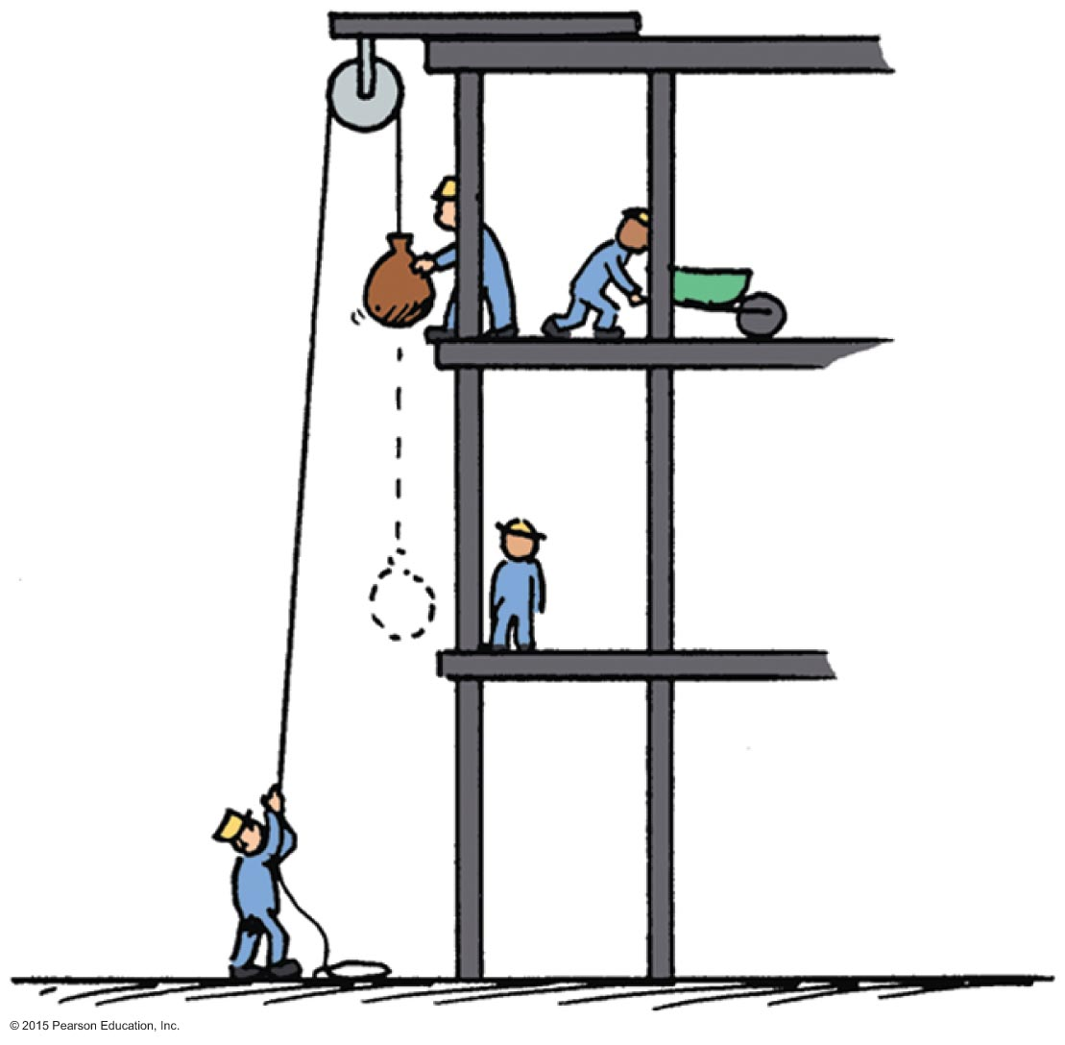
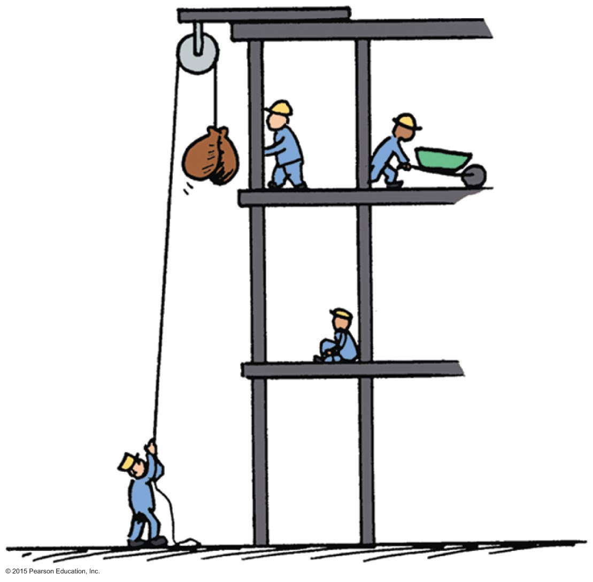
Work
Examples:
  Twice as much work is done in lifting 2 loads 1 story high versus lifting 1 load the same vertical distance.
    Reason: force needed to lift twice the load is twice as much.
  Twice as much work is done in lifting a load 2 stories instead of 1 story.
    Reason: distance is twice as great.

Slide 10
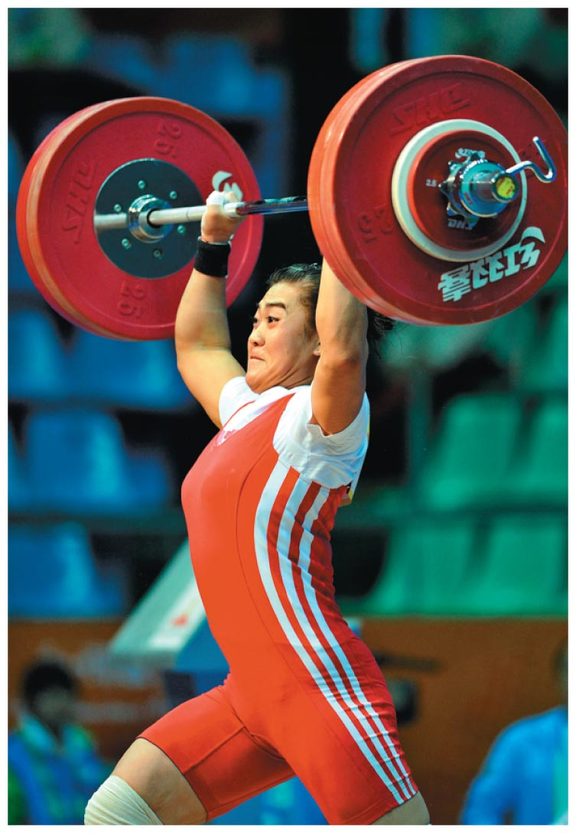
Work
Example:
  a weightlifter raising a barbell from the floor does work on the barbell.
Unit of work:
  newton-meter (Nm) or joule (J)

Slide 11
Work
CHECK YOUR NEIGHBOR
Work is done in lifting a barbell. How much work is done in lifting a barbell that is twice as heavy the same distance?
Twice as much
Half as much
The same
Depends on the speed of the lift
Notes:
A. Twice as much

Slide 12
Work
CHECK YOUR ANSWER
Work is done in lifting a barbell. How much work is done in lifting a barbell that is twice as heavy the same distance?
Twice as much
Half as much
The same
Depends on the speed of the lift
Explanation:
This is in accord with work = force x distance. Twice the force for the same distance means twice the work done on the barbell.
Notes:
A. Twice as much

Slide 13
Work
CHECK YOUR NEIGHBOR
You do work when pushing a cart with a constant force. If you push the cart twice as far, then the work you do is
less than twice as much.
twice as much.
more than twice as much.
zero.
Notes:
B. twice as much.

Slide 14
Work
CHECK YOUR ANSWER
You do work when pushing a cart with a constant force. If you push the cart twice as far, then the work you do is
less than twice as much.
twice as much.
more than twice as much.
zero.
Notes:
B. twice as much.

Slide 15
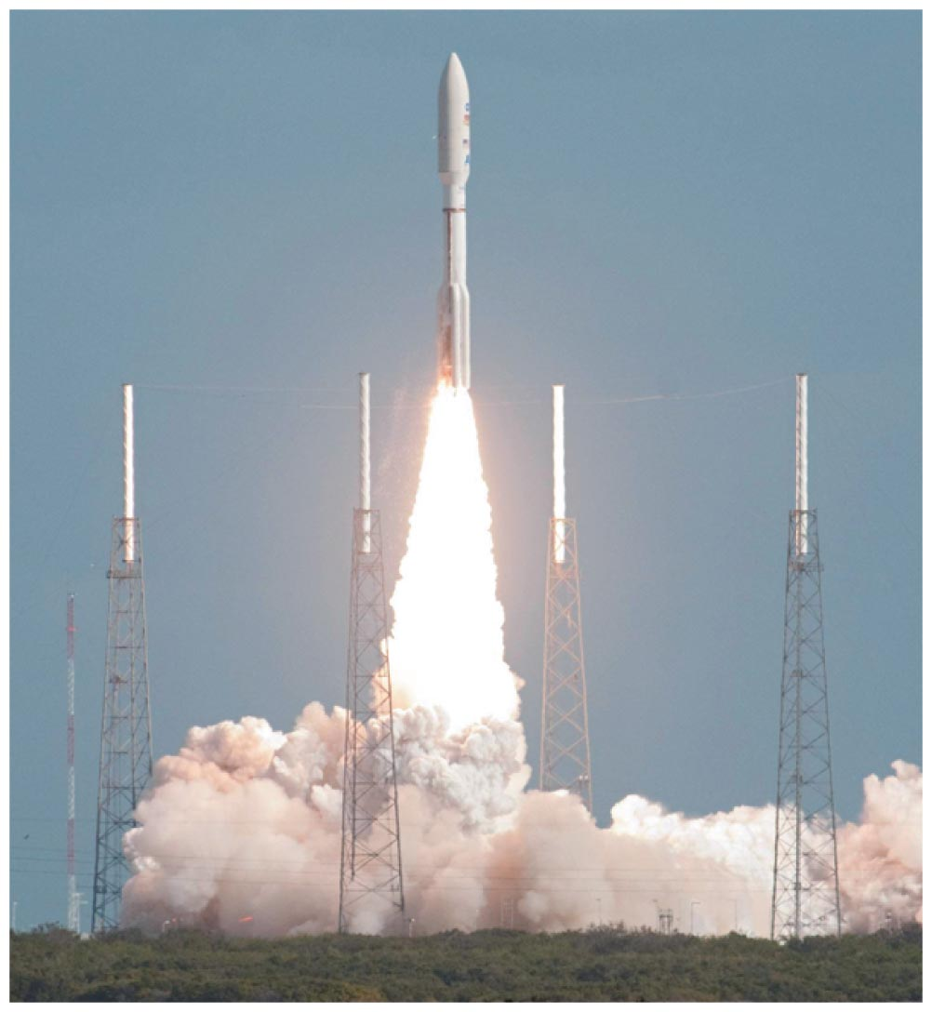
Power
Power:
  Measure of how fast work is done
  In equation form:

Slide 16
Power
Example:
  A worker uses more power running up the stairs than climbing the same stairs slowly.
  Twice the power of an engine can do twice the work of one engine in the same amount of time, or twice the work of one engine in half the time or at a rate at which energy is changed from one form to another.

Slide 17
Power
Unit of power
  joule per second, called the watt after James Watt, developer of the steam engine
    1 joule/second = 1 watt
    1 kilowatt = 1000 watts

Slide 18
Power
CHECK YOUR NEIGHBOR
A job can be done slowly or quickly. Both may require the same amount of work, but different amounts of
energy.
momentum.
power.
impulse.
Notes:
C. power.

Slide 19
Power
CHECK YOUR ANSWER
A job can be done slowly or quickly. Both may require the same amount of work, but different amounts of
energy.
momentum.
power.
impulse.
Comment:
Power is the rate at which work is done.
Notes:
C. power.

Slide 20
Mechanical Energy
Mechanical energy is due to position or to motion, or both.
There are two forms of mechanical energy:
  Potential energy
  Kinetic energy

Slide 21
Potential Energy
Stored energy held in readiness with a potential for doing work
Example:
  A stretched bow has stored energy that can do work on an arrow.
  A stretched rubber band of a slingshot has stored energy and is capable of doing work.

Slide 22
Potential Energy—Gravitational
Potential energy due to elevated position
Example:
  water in an elevated reservoir
  raised ram of a pile driver

Slide 23
Potential Energy—Gravitational
Equal to the work done (force required to move it upward x the vertical distance moved against gravity) in lifting it
In equation form:
  Potential energy
  = mass x acceleration due to gravity x height
  = mgh

Slide 24
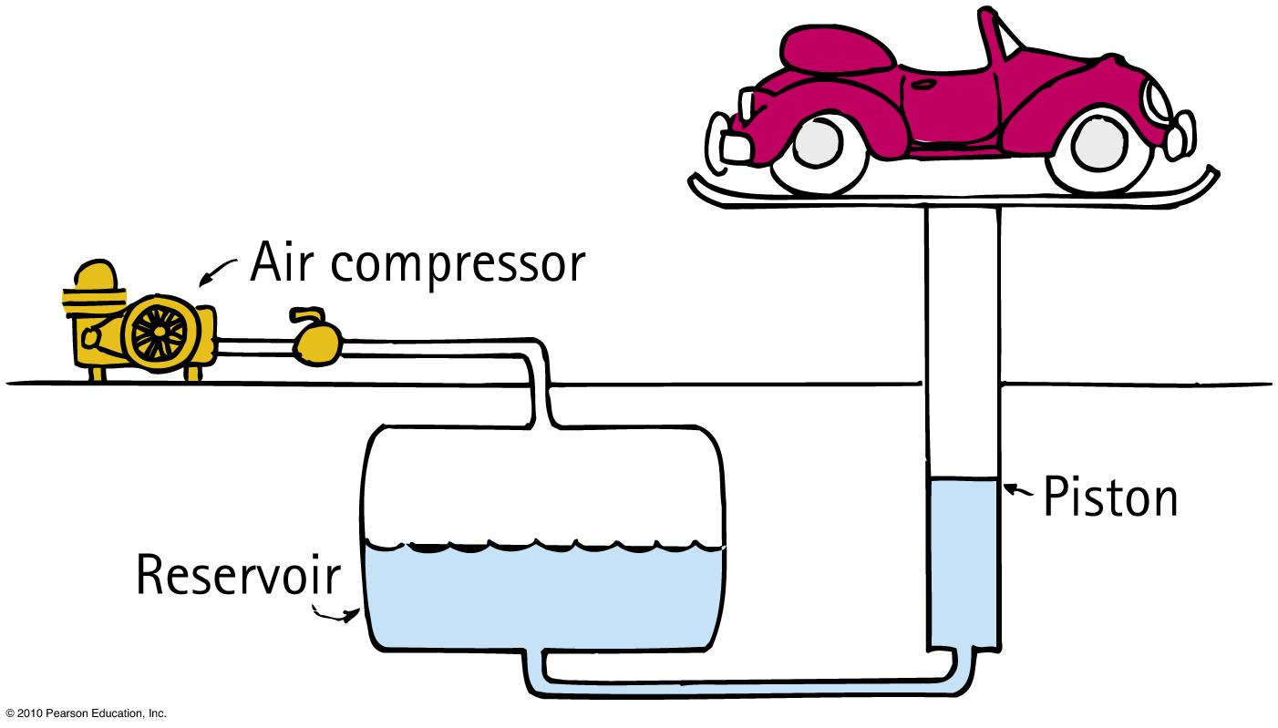
Potential Energy
CHECK YOUR NEIGHBOR
Does a car hoisted for repairs in a service station have increased potential energy relative to the floor?
Yes
No
Sometimes
Not enough information
Notes:
A. Yes

Slide 25
Potential Energy
CHECK YOUR ANSWER
Does a car hoisted for repairs in a service station have increased potential energy relative to the floor?
Yes
No
Sometimes
Not enough information
Comment:
If the car were twice as heavy, its increase in potential energy would be twice as great.
Notes:
A. Yes

Slide 26
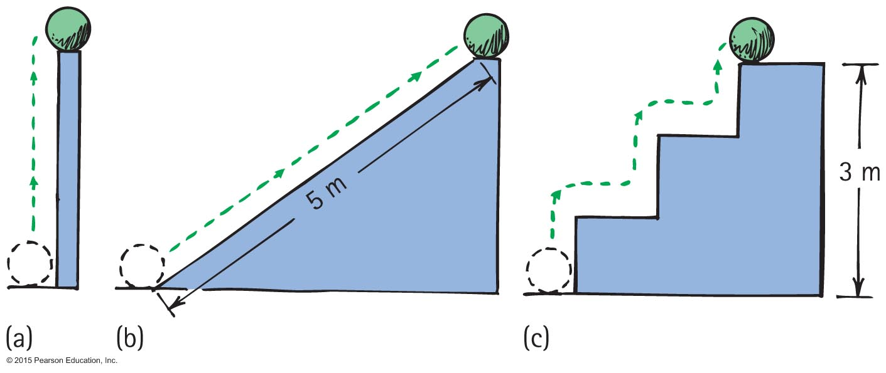
Potential Energy
Example: Potential energy of 10-N ball is the same in all 3 cases because work done in elevating it is the same.

Slide 27
Kinetic Energy
Energy of motion
Depends on the mass of the object and square of its speed
Include the proportional constant 1/2 and kinetic energy = 1/2 x mass x speed x speed
If object speed is doubled ⇒ kinetic energy is quadrupled.

Slide 28
Kinetic Energy
CHECK YOUR NEIGHBOR
Must a car with momentum have kinetic energy?
Yes, due to motion alone
Yes, when motion is nonaccelerated
Yes, because speed is a scalar and velocity is a vector quantity
No
Notes:
A. Yes, due to motion alone

Slide 29
Kinetic Energy
CHECK YOUR ANSWER
Must a car with momentum have kinetic energy?
Yes, due to motion alone
Yes, when motion is nonaccelerated
Yes, because speed is a scalar and velocity is a vector quantity
No
Explanation:
Acceleration, speed being a scalar, and velocity being a vector quantity are irrelevant. Any moving object has both momentum and kinetic energy.
Notes:
A. Yes, due to motion alone

Slide 30
Kinetic Energy
Kinetic energy and work of a moving object
  Equal to the work required to bring it from rest to that speed, or the work the object can do while being brought to rest
  In equation form: net force x distance = kinetic energy, or Fd = 1/2 mv²

Slide 31
Work-Energy Theorem
Work-energy theorem
  Gain or reduction of energy is the result of work.
  In equation form: work = change in kinetic energy (W = ∆KE).
  Doubling speed of an object requires 4 times the work.

Slide 32
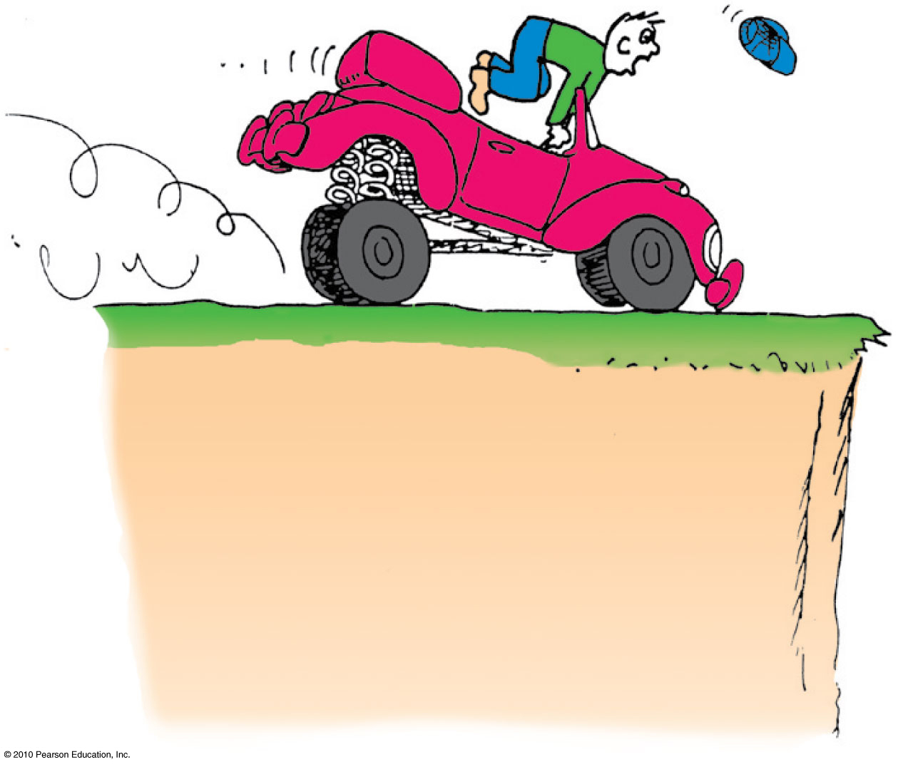
Work-Energy Theorem
Applies to decreasing speed:
  reducing the speed of an object or bringing it to a halt
Example: Applying the brakes to slow a moving car, work is done on it (the friction force supplied by the brakes x distance).

Slide 33
Work-Energy Theorem
CHECK YOUR NEIGHBOR
Consider a problem that asks for the distance of a
fast-moving crate sliding across a factory floor and then coming to a stop. The most useful equation for solving this problem is
A. F = ma.
B. Ft = ∆mv.
C. KE = ¹/₂mv².
D. Fd = ∆¹/₂mv².
Notes:
D. Fd = ∆¹/₂mv².

Slide 34
Work-Energy Theorem
CHECK YOUR ANSWER
Consider a problem that asks for the distance of a
fast-moving crate sliding across a factory floor and then coming to a stop. The most useful equation for solving this problem is
A. F = ma.
B. Ft = ∆mv.
C. KE = ¹/₂mv².
D. Fd = ∆¹/₂mv².
Comment:
The work-energy theorem is the physicist's favorite starting point for solving many motion-related problems.
Notes:
D. Fd = ∆¹/₂mv².

Slide 35
Work-Energy Theorem
CHECK YOUR NEIGHBOR
The work done in bringing a moving car to a stop is the force of tire friction x stopping distance. If the initial speed of the car is doubled, the stopping distance is
actually less.
about the same.
twice.
None of the above.
Notes:
D. None of the above.

Slide 36
Work-Energy Theorem
CHECK YOUR ANSWER
The work done in bringing a moving car to a stop is the force of tire friction x stopping distance. If the initial speed of the car is doubled, the stopping distance is
actually less.
about the same.
twice.
None of the above.
Explanation:
Twice the speed means four times the kinetic energy and four times the stopping distance.
Notes:
D. None of the above.

Slide 37
Conservation of Energy
Law of conservation of energy
  Energy cannot be created or destroyed; it may be transformed from one form into another, but the total amount of energy never changes.

Slide 38
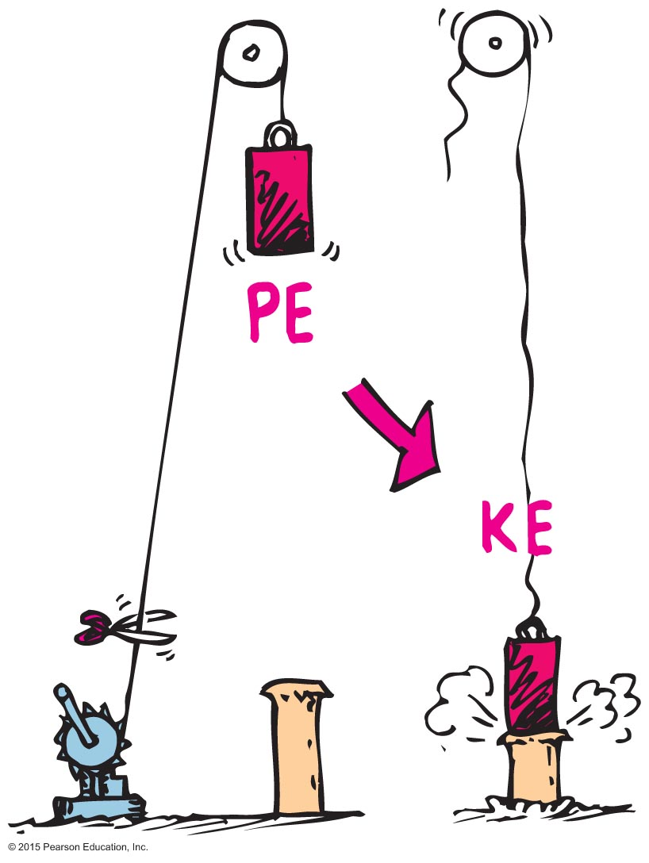
Conservation of Energy
Example: Energy transforms without net loss or net gain in the operation of a pile driver.

Slide 39
Conservation of Energy
A situation to ponder…
Consider the system of a bow and arrow. In drawing the bow, we do work on the system and give it potential energy. When the bowstring is released, most of the potential energy is transferred to the arrow as kinetic energy and some as heat to the bow.

Slide 40
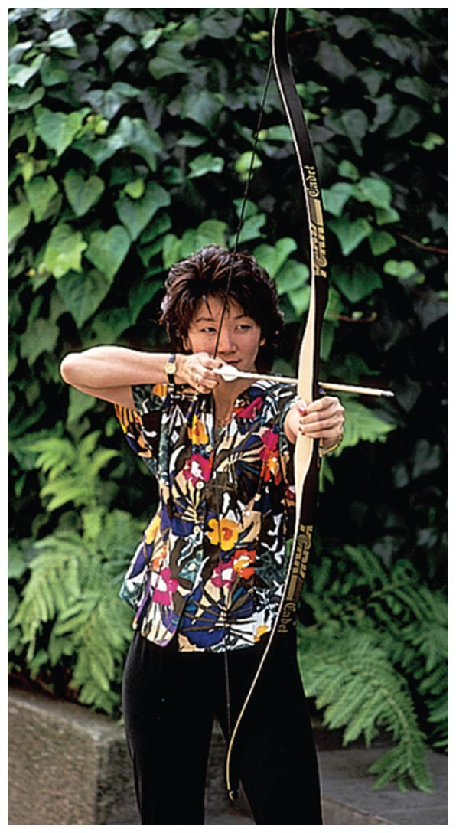
A situation to ponder…
CHECK YOUR NEIGHBOR
Suppose the potential energy of a drawn bow is 50 joules and the kinetic energy of the shot arrow is 40 joules. Then
energy is not conserved.
10 joules go to warming the bow.
10 joules go to warming the target.
10 joules are mysteriously missing.
Notes:
B. 10 joules go to warming the bow.

Slide 41
A situation to ponder…
CHECK YOUR ANSWER
Suppose the potential energy of a drawn bow is 50 joules and the kinetic energy of the shot arrow is 40 joules. Then
energy is not conserved.
10 joules go to warming the bow.
10 joules go to warming the target.
10 joules are mysteriously missing.
Explanation:
The total energy of the drawn bow, which includes
the poised arrow, is 50 joules. The arrow gets 40
joules and the remaining 10 joules warms the
bow—still in the initial system.
Notes:
B. 10 joules go to warming the bow.

Slide 42
Kinetic Energy and Momentum Compared
Similarities between momentum and kinetic energy:
  Both are properties of moving things.
Difference between momentum and kinetic energy:
  Momentum is a vector quantity and therefore is directional and can be canceled.
  Kinetic energy is a scalar quantity and can never be canceled.

Slide 43
Kinetic Energy and Momentum Compared
Velocity dependence
  Momentum depends on velocity.
  Kinetic energy depends on the square of velocity.
  Example: An object moving with twice the velocity of another with the same mass, has twice the momentum but 4 times the kinetic energy.

Slide 44
Machines
Machine
  Device for multiplying forces or changing the direction of forces
  Cannot create energy but can transform energy from one form to another, or transfer energy from one location to another
  Cannot multiply work or energy

Slide 45
Machines
Principle of a machine
  Conservation of energy concept:
  Work input = work output
  Input force x input distance =
  Output force x output distance
  (Force x distance)_{input} = (force x distance)_{output}

Slide 46
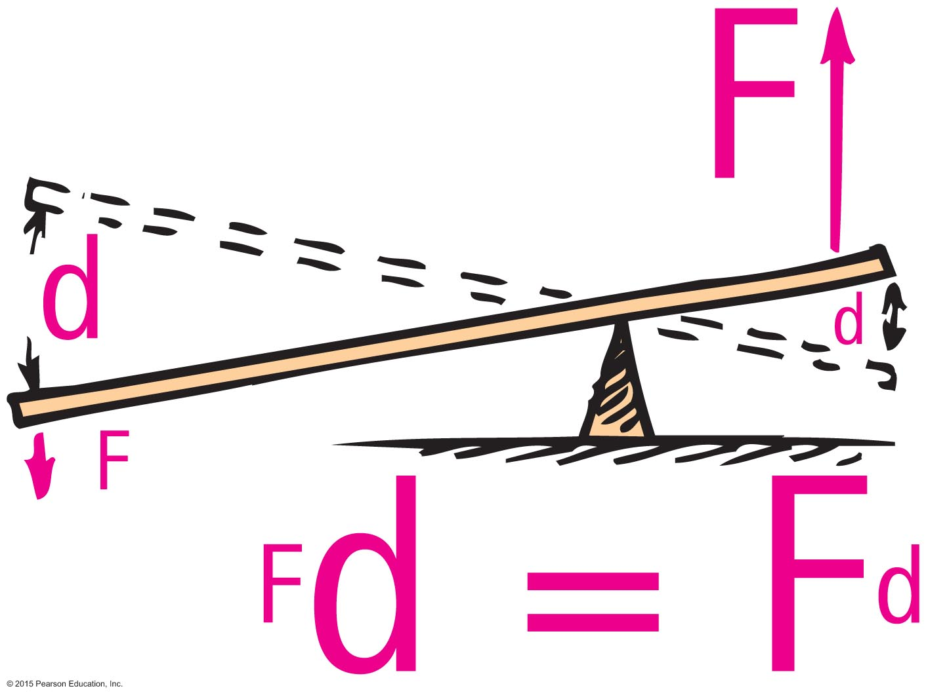
Machines
Simplest machine
  Lever
    rotates on a point of support called the fulcrum
    allows small force over a large distance and large force over a short distance

Slide 47
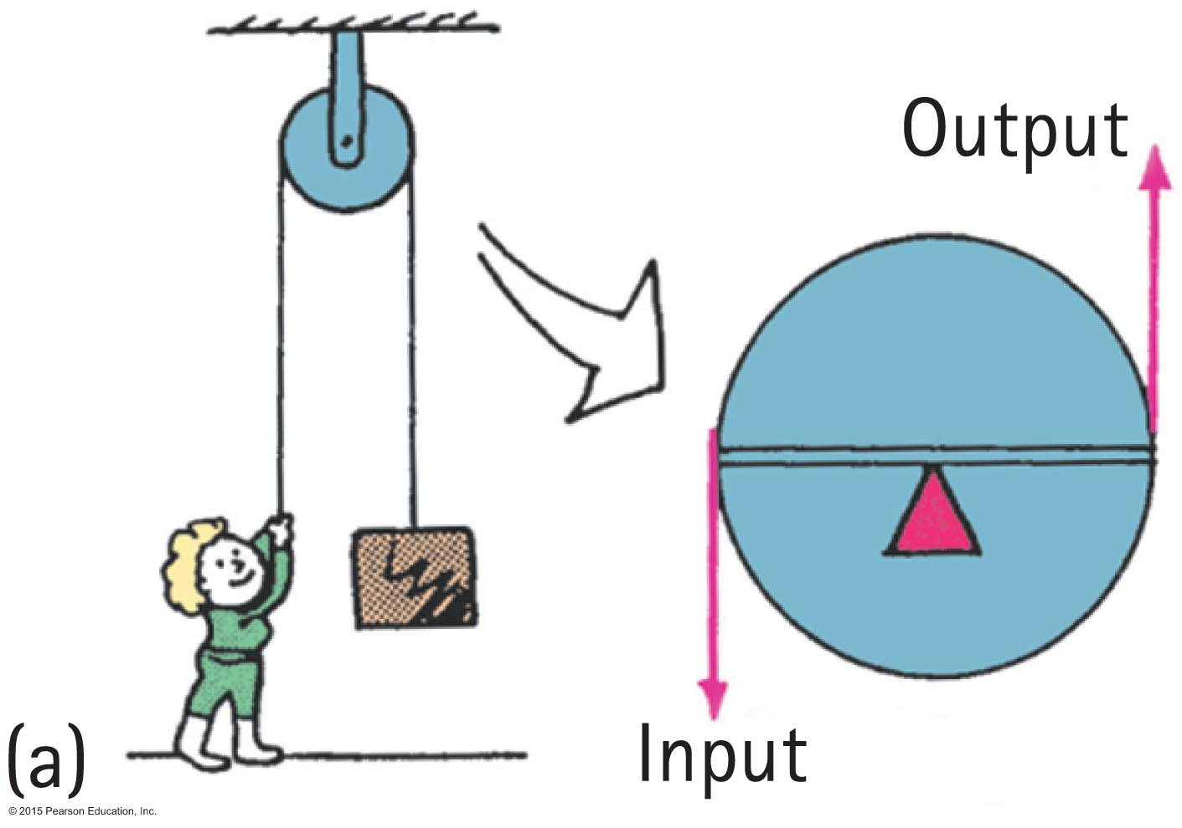
Machines
Pulley
  operates like a lever with equal arms— changes the direction of the input force
Example:
  This pulley arrangement can allow a load to be lifted with half the input force.

Slide 48
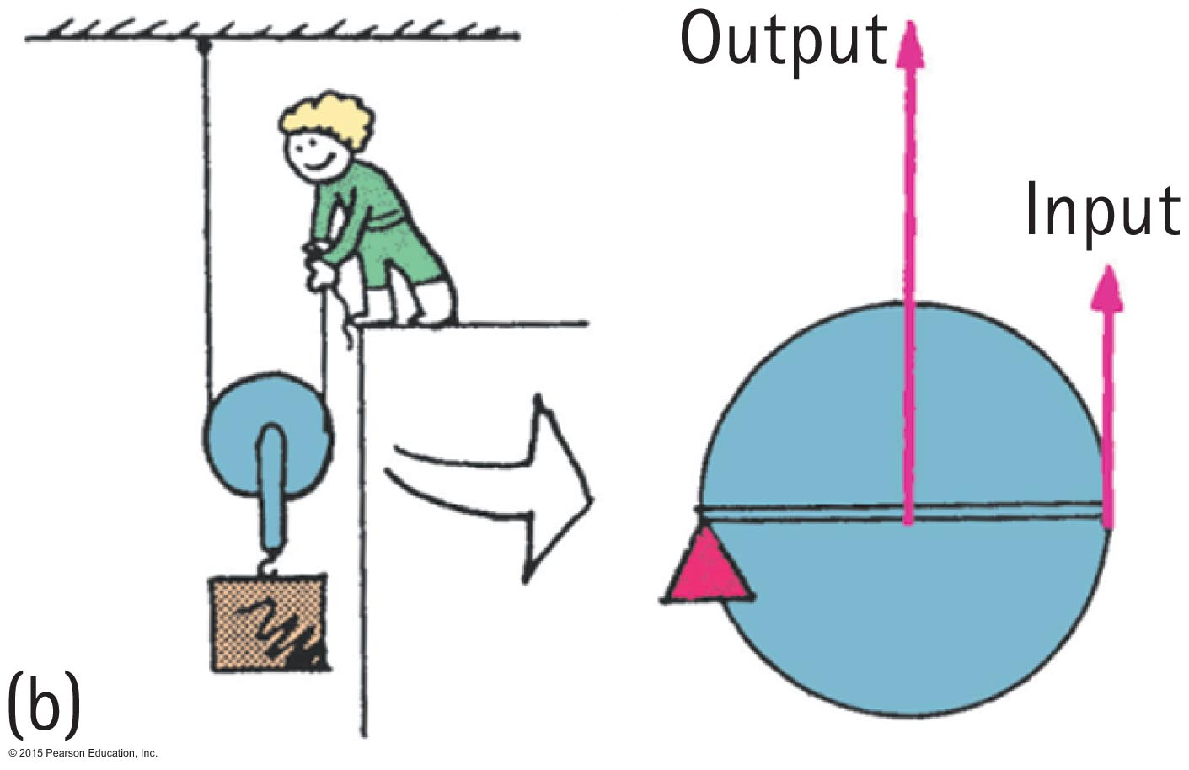
Machines
Operates as a system of pulleys (block and tackle)
Multiplies force

Slide 49
Machines
CHECK YOUR NEIGHBOR
In an ideal pulley system, a woman lifts a 100-N crate by pulling a rope downward with a force of 25 N. For every
1-meter length of rope she pulls downward, the crate rises
50 centimeters.
45 centimeters.
25 centimeters.
None of the above.
Notes:
C. 25 centimeters.

Slide 50
Machines
CHECK YOUR ANSWER
In an ideal pulley system, a woman lifts a 100-N crate by pulling a rope downward with a force of 25 N. For every
1-meter length of rope she pulls downward, the crate rises
50 centimeters.
45 centimeters.
25 centimeters.
None of the above.
Explanation:
Work in = work out; Fd in = Fd out.
One-fourth of 1 m = 25 cm.
Notes:
C. 25 centimeters.

Slide 51
Efficiency
Efficiency
  Percentage of work put into a machine that is converted into useful work output
  In equation form:
useful energy output
Efficiency =
total energy input

Slide 52
Efficiency
CHECK YOUR NEIGHBOR
A certain machine is 30% efficient. This means the machine will convert
30% of the energy input to useful work—
70% of the energy input will be wasted.
70% of the energy input to useful work—30% of the energy input will be wasted.
Both of the above.
None of the above.
Notes:
A. 30% of the energy input to useful work—70% of the energy input will be wasted.

Slide 53
Efficiency
CHECK YOUR ANSWER
A certain machine is 30% efficient. This means the machine will convert
30% of the energy input to useful work—70% of the energy input will be wasted.
70% of the energy input to useful work—30% of the energy input will be wasted.
Both of the above.
None of the above.
Notes:
A. 30% of the energy input to useful work—70% of the energy input will be wasted.

Slide 54
Recycled Energy
Re-employment of energy that otherwise would be wasted.
Edison used heat from his power plant in New York City to heat buildings.
Typical power plants waste about 30% of their energy to heat because they are built away from buildings and other places that use heat.

Slide 55
Energy for Life
Body is a machine, so it needs energy.
Our cells feed on hydrocarbons that release energy when they react with oxygen (like gasoline burned in an automobile).
There is more energy stored in the food than in the products after metabolism.

Slide 56
Sources of Energy
Sources of energy
  Sun
    Example:
      Sunlight evaporates water; water falls as rain; rain flows into rivers and into generator turbines; then back to the sea to repeat the cycle.
      Sunlight can be transformed into electricity by photovoltaic cells.
      Wind power turns generator turbines.

Slide 57
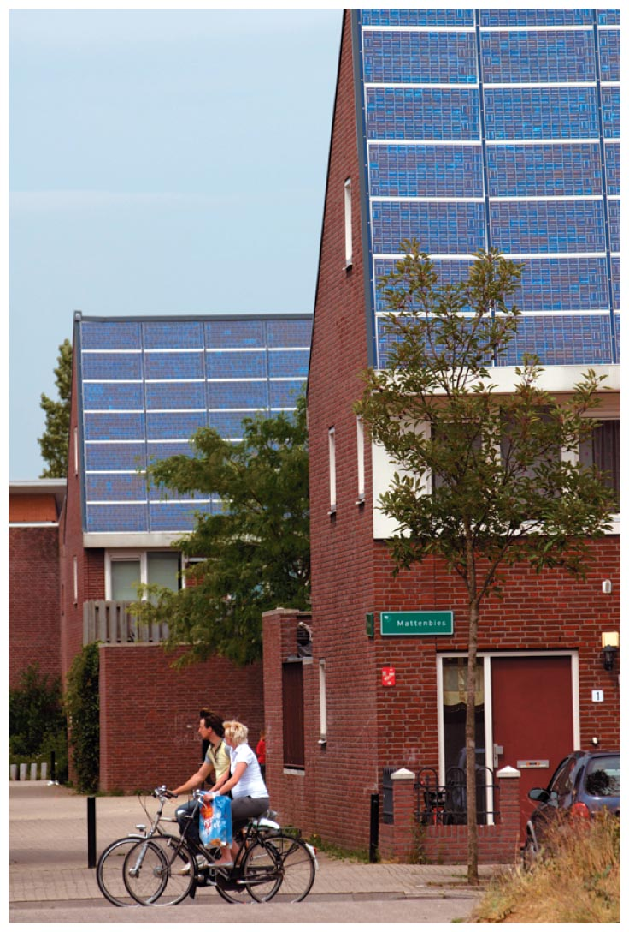
Sources of Energy
Sources of energy
  Sun
    Example:
      Photovoltaic cells on
      rooftops catch the solar
      energy and convert it to
      electricity.
More energy from the Sun hits Earth in 1 hour than all of the energy consumed by humans in an entire year!

Slide 58
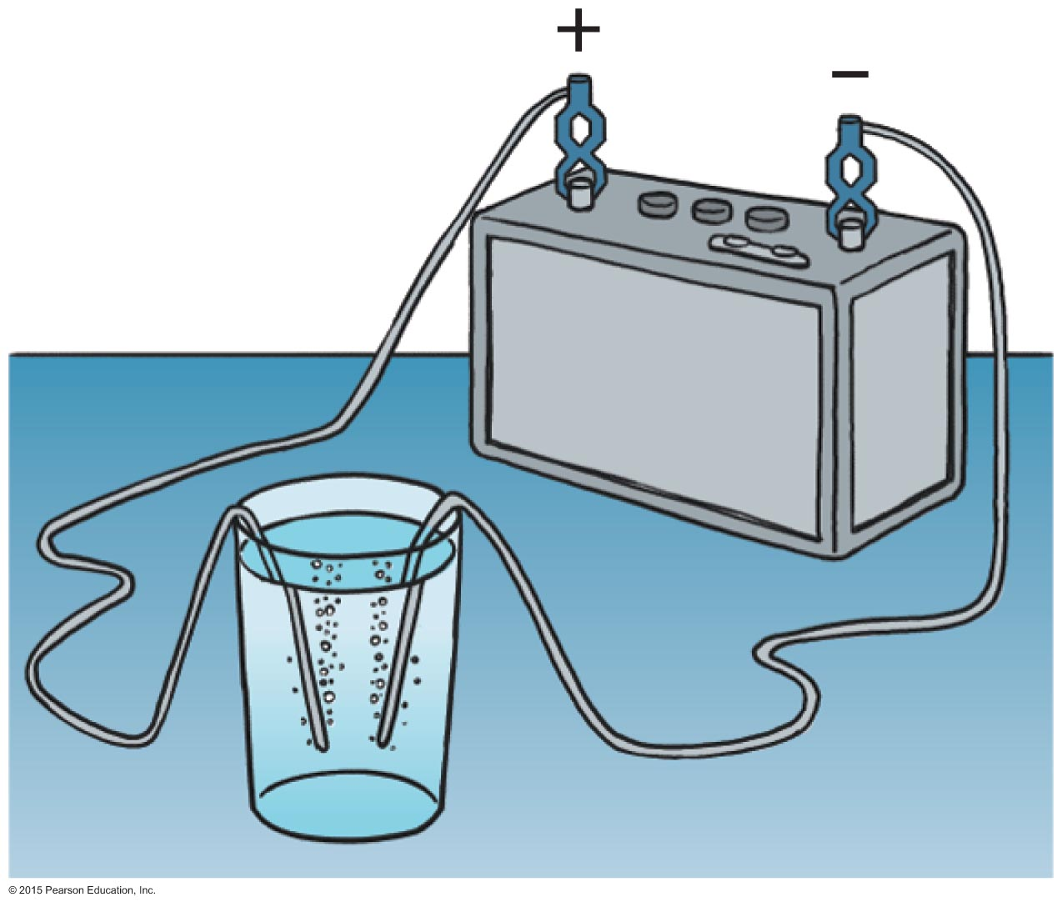
Sources of Energy
Fuel cell
  Runs opposite to the battery shown (where electricity separates water into hydrogen and oxygen).
  In a fuel cell, hydrogen and oxygen are compressed at electrodes and electric current is produced at electrodes.

Slide 59
Sources of Energy
Concentrated energy
  Nuclear power
    stored in uranium and plutonium
    by-product is geothermal energy
      held in underground reservoirs of hot water to provide steam that can drive turbogenerators

Slide 60
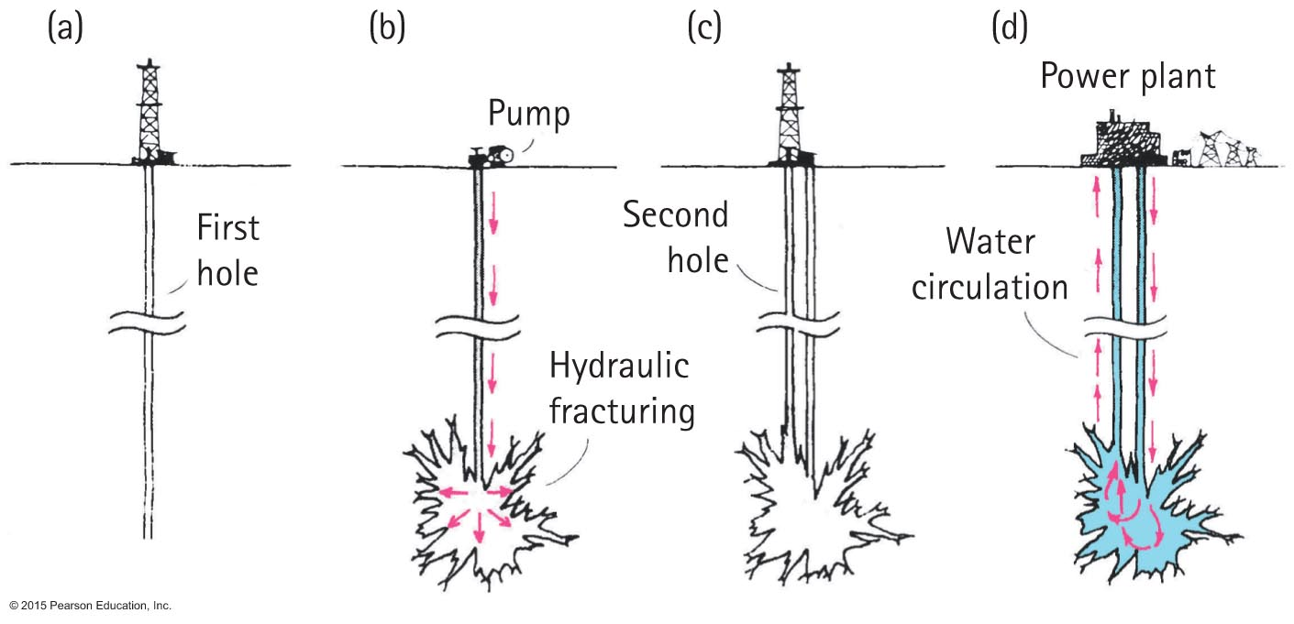
Sources of Energy
Dry-rock geothermal power is a producer of electricity.
  Water is put into cavities in deep, dry, hot rock. Water turns to steam and reaches a turbine, at the surface. After exiting the turbine, it is returned to the cavity for reuse.

